Slide 1
Weekly report: Grid Code Development
Week number: 2
Date: 7/10/2025
Supervisor: Prof. Ing. Saiju
Presented by: Josef Remberger / Vijay Simha Reddy Bogala

Slide 2
List of contents
Grid operation states
Emergency / extreme fault conditions
Restorative / Black Start
Special connection conditions
Withstanding short circuits in the grid
Reactive Range & Voltage Control
Outlook for the coming week
Bibliography

Slide 3
1-i. Emergency / extreme fault conditions
Definition: That actual condition of the Power System when, due to the occurrence of one or more incidents, a part or the whole of the Power System has experienced excessive frequency deviations or Transmission voltage deviations
Frequency: 47.5 ≤ X ≥ 51.5 Hz
Voltage:
59.5 < X > 72.5 kV
207.0 < X > 241.5 kV
[1]

Slide 4
1-ii. Restorative / Black Start
Definition: The procedure necessary for a System recovery from a Total Blackout or Partial Blackout
Wind turbines are not entitled for Black Start
[1]

Slide 5
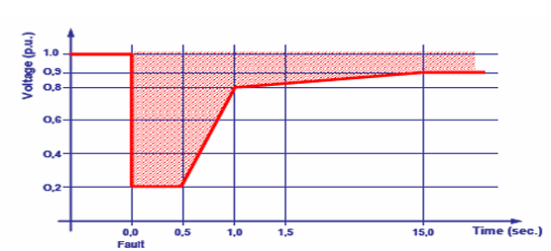
2-i. Withstanding short circuits in the grid
Wind generators must remain connected during and after cleared short circuits
They shall withstand voltage disturbances even under second-level protection actions
Voltage Profile Recovery of Wind Generators During and After a Short Circuit Fault; [1]; (04/10/2025)
[1]

Slide 6
2-i. Withstanding short circuits in the grid
Wind generators must withstand a 0.5 s short circuit causing voltage dips down to 20% voltage p.u.
Voltage should recover to ≥ 80 % voltage p.u. within 1 s and ≥ 90 % voltage p.u. within 15 s after fault clearance
Wind generators must remain connected during voltage dips of similar or lower severity
They shall recover at least 90 % of pre-fault output within 1 minute after the short circuit
[1]

Slide 7
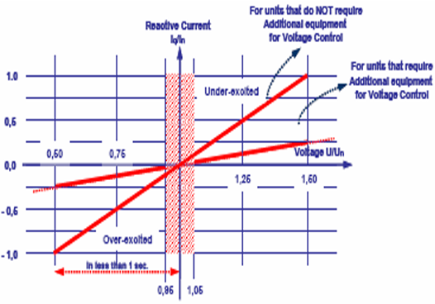
2-ii. Reactive Range & Voltage Control
Dead band of 5 % of nominal voltage is defined for normal operational conditions, with two different allowed operative conditions
Constant Power factor
Participate in Voltage Control
Minimum requirements for a non-synchronous machine in
voltage control; [1]; (04/10/2025)
[1]

Slide 8
2-ii. Reactive Range & Voltage Control
Outside the dead band ability to participate for recovery of voltage
Two different expectations according with the design of non-synchronous machines
Voltage-controlling units: Provide full reactive current (≈ nominal current) for voltages ≤ 50 %; response < 1 s.
Non-voltage-controlling units: Provide up to 25 % capacity (half of nominal to reactive current) via external equipment; response < 1 s
Wind generators must stay connected and stable for voltage variations between 90–110 % of nominal Voltage at the connection point
[1]

Slide 9
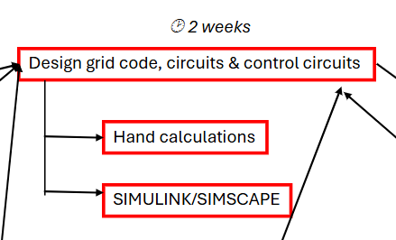
3. Outlook for the coming week

Slide 10
Bibliography – Grid Code Development
[1] SYRRIAN ARAB REPUBLIC / Ministry of Electricity / PETE / Transmission Grid Code, 2014 (accessed Sept. 27, 2025)

